Slide 1

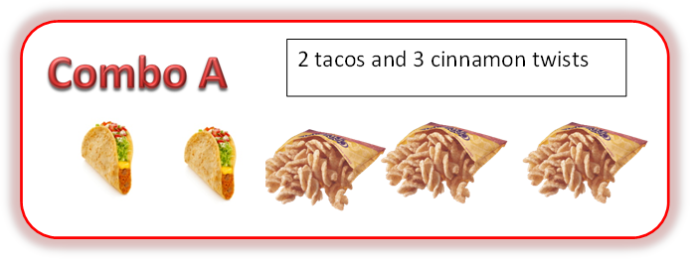
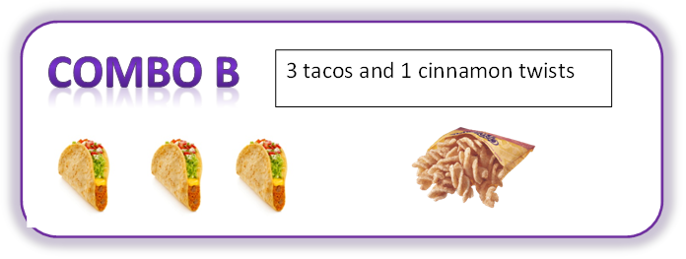
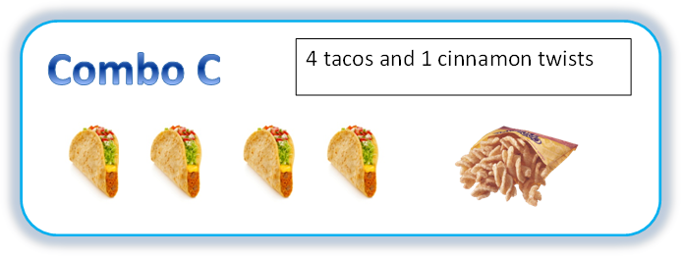
Lydia went to her favorite restaurant, Taco Shell, to order dinner for her family.

Slide 2

Her brother wanted a Combo A.

Slide 3
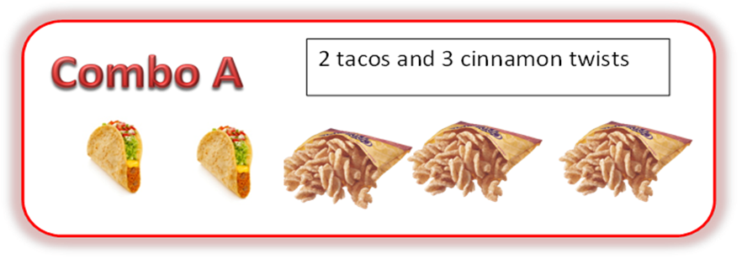

Her sister wanted a Combo A too.

Slide 4
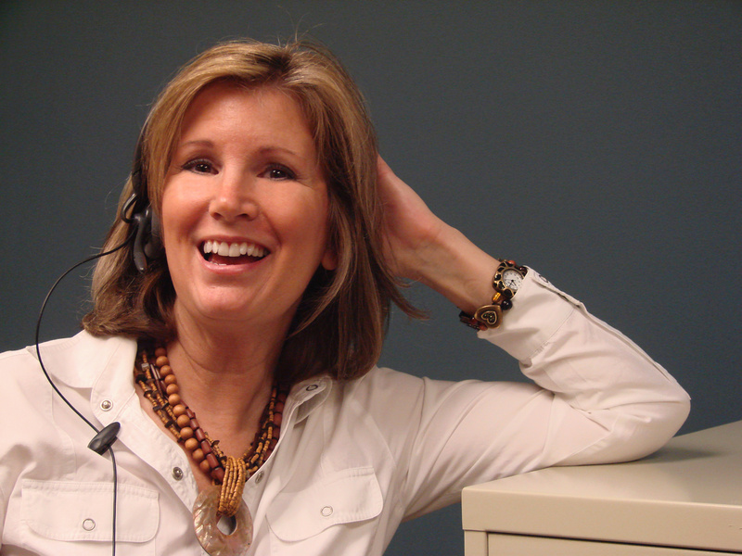
Lydia’s mom wanted a Combo C.

Slide 5

Lydia’s dad also wanted a Combo C.

Slide 6
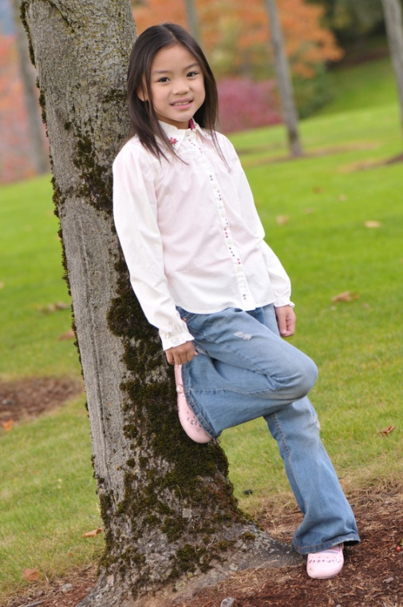
Lydia really likes cinnamon twists so she chose a Combo A too.

Slide 7
In all, her family wanted 3 combo As and 2 combo Cs.

Slide 8
When Taco Shell gave her the food, it was all wrapped up and in a bag.
TACOSHELL
TS
TS

Slide 9

Lydia needed to check to make sure all of the food was in the bag. She needs your help….
TACOSHELL
TS
TS

Slide 10
How can distributive property help Lydia find out how many items of food should be in her bag?
TACOSHELL
TS
TS

Slide 11
Remember this?
In all, her family wanted 3 combo As and 2 combo Cs.
We can group these into a multiplication problem…

Slide 12
We can group these into a multiplication problem…
3 x ( _________)
+
2 x ( _________)
_____________

Slide 13
We can group these into a multiplication problem…
3 x ( _________)
+
2 x ( _________)
_____________
2
3
3 x ( __T+__C)
+
4
1
2 x ( __T+__C)

Slide 14
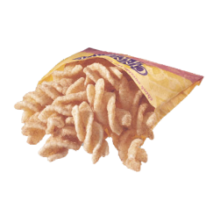
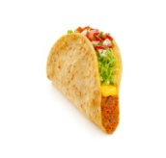
We can group these into a multiplication problem…
2
3 x ( __T+__C)
3
3
(3 x __T )+
(3 x __C )
2
6
+
9
= 15 food items for 3 Combo As

Slide 15
We can group these into a multiplication problem…
4
1
2 x ( __T+__C)
1
(2 x __T )+
(2 x __C )
4
8
+
2
= 10 food items for 2 Combo Cs

Slide 16
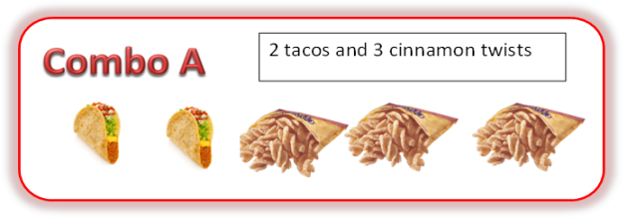
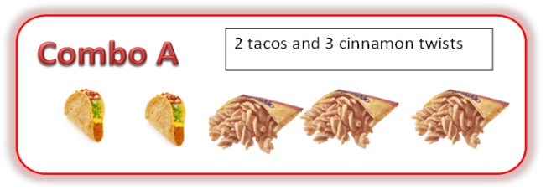

In all, her family wanted 3 combo As and 2 combo Cs.
15 food items for 3 Combo As
+ 10 food items for 2 Combo Cs
= 25 food items in the bag

Slide 17
TACOSHELL
When Taco Shell gave her the food, it was all wrapped up and in a bag.
TS
TS
= 25 food items in the bag

