Slide 1
Insert Graph Here!

Slide 2
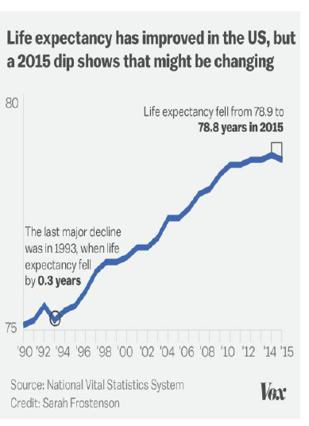
Insert Graph Here!

